Slide 1


Green Pace
Security Policy Presentation
Developer: Keegan Sevener

Slide 2

OVERVIEW: DEFENSE IN DEPTH
Defense-in-depth is the utilization of multiple security methods to secure a system.
The security policy for Green Pace helps support a defense-in-depth strategy by outline best practices and coding standards which add multiple layers of security and ensures consistent and secure programming. This creates clear guidance for employees (Dunham, 2020).

Slide 3
THREATS MATRIX
Likely Likely vulnerabilities are STD-004-CPP, STD-007-CPP, and STD-008-CPP. These standards encapsulate security risks such as SQL injections, exceptions, and smart pointers. These risks are more likely to be exploited. | Priority High priority vulnerabilities are STD-001-CPP, STD-004-CPP, STD-005-CPP, and STD-008-CPP. These risks include memory protection and ensuring consistent data types. They have high severity and/or likelihood.
Low priority Low priority vulnerabilities STD-006-CPP and STD-007-CPP regard assertions and exceptions. Medium priority vulnerabilities STD-003-CPP and STD-010-CPP concern string correctness and properly catching errors in constructors. | Unlikely Unlikely vulnerabilities such as STD-001-CPP, STD-002-CPP, and STD-006-CPP regard issues such as properly using assertions and ensuring integrity of data values to prevent buffer overflows. These risks are less likely to be exploited.

Slide 4
10 PRINCIPLES
Principle 1: Validate Input Data | Principle 2: Heed Compiler Warnings | Principle 3: Architect and Design for Security Policies | Principle 4: Keep It Simple | Principle 5: Default Deny
STD-004-CPP | STD-007-CPP | STD-001-CPP STD-002-CPP STD-003-CPP STD-006-CPP STD-007-CPP STD-008-CPP STD-009-CPP STD-010-CPP | STD-001-CPP STD-002-CPP STD-003-CPP STD-008-CPP | STD-002-CPP
Principle 6: Adhere to the Principle of Least Privilege | Principle 7: Sanitize Data Sent to Other Systems | Principle 8: Practice Defense in Depth | Principle 9: Use Effective Quality Assurance Techniques | Principle 10: Adopt a Secure Coding Standard
STD-004-CPP STD-005-CPP | STD-004-CPP | STD-004-CPP | STD-005-CPP STD-006-CPP | STD-001-CPP STD-002-CPP STD-004-CPP STD-006-CPP STD-008-CPP STD-009-CPP

Slide 5
CODING STANDARDS
Rule | Severity | Likelihood | Remediation Cost | Priority | Level
STD-004-CPP | High | Likely | Medium | High | 5
STD-008-CPP | High | Likely | Medium | High | 4
STD-001-CPP | High | Unlikely | High | High | 4
STD-005-CPP | High | Probable | Medium | High | 4
STD-003-CPP | High | Probable | Medium | Medium | 3
STD-009-CPP | Medium | Probable | Medium | Medium | 3
STD-010-CPP | Low | Probable | High | Medium | 3
STD-002-CPP | Medium | Unlikely | Medium | Medium | 2
STD-006-CPP | Medium | Unlikely | Medium | Low | 2
STD-007-CPP | Low | Likely | Low | Low | 1

Slide 6
ENCRYPTION POLICIES
Encryption at rest
- Protecting data sitting in a database/hard-drive.
Encryption in flight
- Protecting data being transferred within a system, to another system, or over a network.
Encryption in use
Protecting data that is being transformed/altered.
Best way to protect data in use is to limit access by user role (Froehlich, 2022).

Slide 7
TRIPLE-A POLICIES
Authentication
- The process of identifying a user
Authorization
- The process of controlling a user’s level of access
Accounting
- The process of tracking/recording user activity in a system.

Slide 8
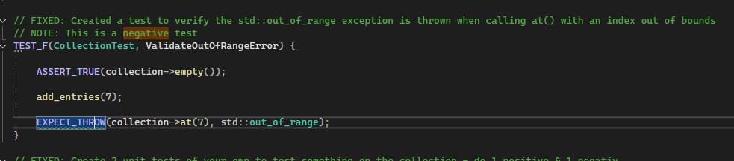
Unit Testing Validate Out of Range Error
This test checks for exception throw when trying to access an out-of-range memory location.
Test:
Result:

Slide 9
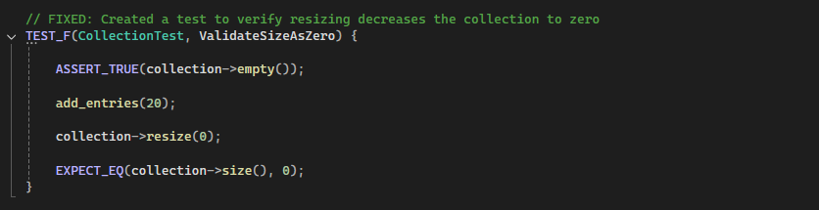
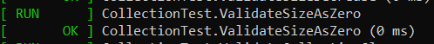
Unit Testing Validate Size as Zero
This test checks that the collection is successfully resized to zero after being filled with a set number of entries.
Test:
Results:

Slide 10
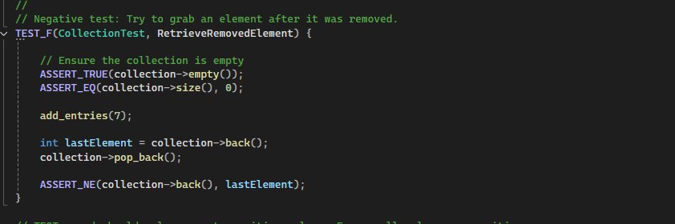
Unit Testing Retrieve Removed Element
This tests checks that a value is successfully removed by attempting to retrieve it after removal and comparing the values.
Test:
Results:

Slide 11
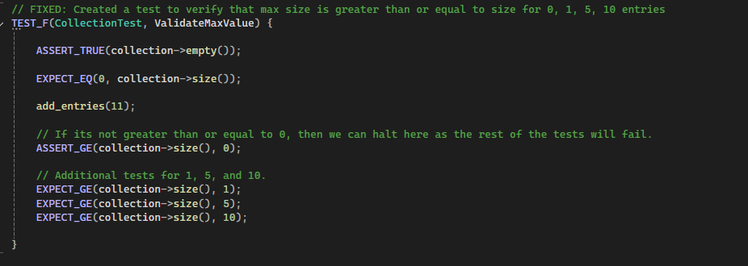
Unit Testing Validate Max Value
This test validates that the collection’s size is greater than a certain value with multiple checks.
Test:
Results:

Slide 12

AUTOMATION SUMMARY

Slide 13
TOOLS
CPPCheck - static code analysis (https://cppcheck.sourceforge.io/)
Parasoft - automated testing suite (https://www.parasoft.com/)
GoogleTest – unit testing framework (https://google.github.io/googletest/)

Slide 14
RISKS AND BENEFITS
- Risks
Software is more difficult to secure if you wait until the end.
Waiting can make software less secure, more prone to attack.
Security requirements and employee responsibilities are ill-defined (Dunham, 2020).
- Benefits
Incorporating security from the beginning makes development requirements clearer.
Security is easier to add.
A security mindset is reinforced within the entire development team.
Better accountability for security practices (Dunham, 2020).

Slide 15
RECOMMENDATIONS
Start small and work through code iteratively (Microsoft, n.d.).
Make sure one piece of software is secure before moving on.
Ensure security is a culture (Microsoft, n.d.), not an afterthought.
Review Security policy at least once a year (Dunham, 2020).
Do not abandon reliable security practices like Lenovo (Timpson, 2015).

Slide 16
CONCLUSIONS
Security is an evolving field
Explore new encryption in use software methods such as homomorphic encryption (Velimirovic, 2023).
“No one is safe”, zero trust mindset moving forward (Brook, 2024).
Artificial intelligence solutions in advanced threat protection and intrusion prevention (Fortinet, n.d.).

Slide 17
REFERENCES
Brook, C. (2024, October 23). Understanding the zero trust security model to safeguard digital infrastructure. Digital Guardian. https://www.digitalguardian.com/blog/understanding-zero-trust-security-model-safeguard-digital-infrastructure
Dunham, R. (2020, May 5). The importance of a company information security policy. Linford & Company LLP. https://linfordco.com/blog/information-security-policies/
Fortinet. (n.d.). Artificial Intelligence (AI) in cybersecurity: The Future of Threat Defense. Fortinet. https://www.fortinet.com/resources/cyberglossary/artificial-intelligence-in-cybersecurity
Froehlich, A. (2022, July 28). How to secure data at rest, in use and in Motion. Search Security. https://www.techtarget.com/searchsecurity/feature/Best-practices-to-secure-data-at-rest-in-use-and-in-motion
Microsoft. (n.d.). What is DevSecOps? definition and best practices: Microsoft security. What Is DevSecOps?
Definition and Best Practices | Microsoft Security. https://www.microsoft.com/en- us/security/business/security-101/what-is-devsecops
Timpson, D. (2015, February 20). Lenovo’s superfish adware and the perils of self-signed certificates. DigiCert. https://www.digicert.com/blog/lenovos-superfish-adware-perils-self-signed-certificates
Velimirovic, A. (2023, November 16). Data Encryption in use explained. phoenixNAP Blog. https://phoenixnap.com/blog/encryption-in-use
Vijay. (2025, May 9). What is negative testing? how to write negative test cases
& scenarios. What is Negative Testing? How to Write Negative Test Cases & Scenarios. https://www.softwaretestinghelp.com/what-is-negative-testing/

